Slide 1

Multiplexing/demultiplexing
multiplexing at sender:
handle data from multiple
sockets, add transport header (later used for demultiplexing)
demultiplexing at receiver:
use header info to deliver
received segments to correct
socket
application
application
P1
P2
application
socket
P3
transport
P4
process
transport
network
transport
network
link
network
link
physical
link
physical
physical

Slide 2
How demultiplexing works
host receives IP datagrams
each datagram has source IP address, destination IP address
each datagram carries one transport-layer segment
each segment has source, destination port number
host uses IP addresses & port numbers to direct segment to appropriate socket
32 bits
source port #
dest port #
other header fields
application
data
(payload)
TCP/UDP segment format

Slide 3
Connectionless demultiplexing
recall: when creating datagram to send into UDP socket, must specify
destination IP address
destination port #
recall: created socket has host-local port #:
DatagramSocket mySocket1 = new DatagramSocket(12534);
when host receives UDP segment:
checks destination port # in segment
directs UDP segment to socket with that port #
IP datagrams with same dest. port #, but different source IP addresses and/or source port numbers will be directed to same socket at dest

Slide 4
Connectionless demux: example
DatagramSocket serverSocket = new DatagramSocket
(6428);
DatagramSocket mySocket2 = new DatagramSocket
(9157);
DatagramSocket mySocket1 = new DatagramSocket (5775);
application
application
P1
application
P3
P4
transport
transport
network
transport
network
link
network
link
physical
link
physical
physical
source port: 6428
dest port: 9157
source port: ?
dest port: ?
source port: 9157
dest port: 6428
source port: ?
dest port: ?

Slide 5
Connection-oriented demux
TCP socket identified by 4-tuple:
source IP address
source port number
dest IP address
dest port number
demux: receiver uses all four values to direct segment to appropriate socket
server host may support many simultaneous TCP sockets:
each socket identified by its own 4-tuple
web servers have different sockets for each connecting client
non-persistent HTTP will have different socket for each request

Slide 6
Connection-oriented demux: example
application
application
P4
P5
P6
application
P3
P2
P3
transport
transport
network
transport
network
link
network
link
physical
link
physical
server: IP address B
physical
host: IP address A
source IP,port: B,80
dest IP,port: A,9157
host: IP address C
source IP,port: C,5775
dest IP,port: B,80
source IP,port: A,9157
dest IP, port: B,80
source IP,port: C,9157
dest IP,port: B,80
three segments, all destined to IP address: B,
dest port: 80 are demultiplexed to different sockets

Slide 7
Connection-oriented demux: example
threaded server
application
application
application
P4
P3
P3
P2
transport
transport
network
transport
network
link
network
link
physical
link
physical
server: IP address B
physical
host: IP address A
source IP,port: B,80
dest IP,port: A,9157
host: IP address C
source IP,port: C,5775
dest IP,port: B,80
source IP,port: A,9157
dest IP, port: B,80
source IP,port: C,9157
dest IP,port: B,80

Slide 8
TCP flow control
application
process
application may
remove data from
TCP socket buffers ….
application
TCP socket
receiver buffers
OS
… slower than TCP
receiver is delivering
(sender is sending)
TCP
code
flow control
IP
code
receiver controls sender, so sender won’t overflow receiver’s buffer by transmitting too much, too fast
from sender
receiver protocol stack

Slide 9
TCP Header
Source port
Destination port
Sequence number
Flags:
SYN
FIN
RST
PSH
URG
ACK
Acknowledgment
HdrLen
0
Flags
Advertised window
Checksum
Urgent pointer
Options (variable)
Data

Slide 10
TCP flow control
receiver “advertises” free buffer space by including rwnd value in TCP header of receiver-to-sender segments
RcvBuffer size set via socket options (typical default is 4096 bytes)
many operating systems autoadjust RcvBuffer
sender limits amount of unacked (“in-flight”) data to receiver’s rwnd value
guarantees receive buffer will not overflow
to application process
RcvBuffer
buffered data
rwnd
free buffer space
TCP segment payloads
receiver-side buffering

Slide 11
TCP seq. numbers, ACKs
Host A
Host B
User
types
‘C’
Seq=42, ACK=79, data = ‘C’
host ACKs
receipt of
‘C’, echoes
back ‘C’
Seq=79, ACK=43, data = ‘C’
host ACKs
receipt
of echoed
‘C’
Seq=43, ACK=80
simple telnet scenario

Slide 12
Performance of Stop and Wait ARQ
e.g.: 1 Gbps link, 15 ms prop. delay, 8000 bit packet:
L
8000 bits
D_{trans} =
=
=
8 microsecs
R
10⁹ bits/sec
U _{sender}: utilization – fraction of time sender busy sending
if RTT=30 msec, 1KB pkt every 30 msec: 33kB/sec thruput over 1 Gbps link
network protocol limits use of physical resources!

Slide 13
stop-and-wait operation
sender
receiver
first packet bit transmitted, t = 0
last packet bit transmitted, t = L / R
first packet bit arrives
RTT
last packet bit arrives, send ACK
ACK arrives, send next
packet, t = RTT + L / R

Slide 14
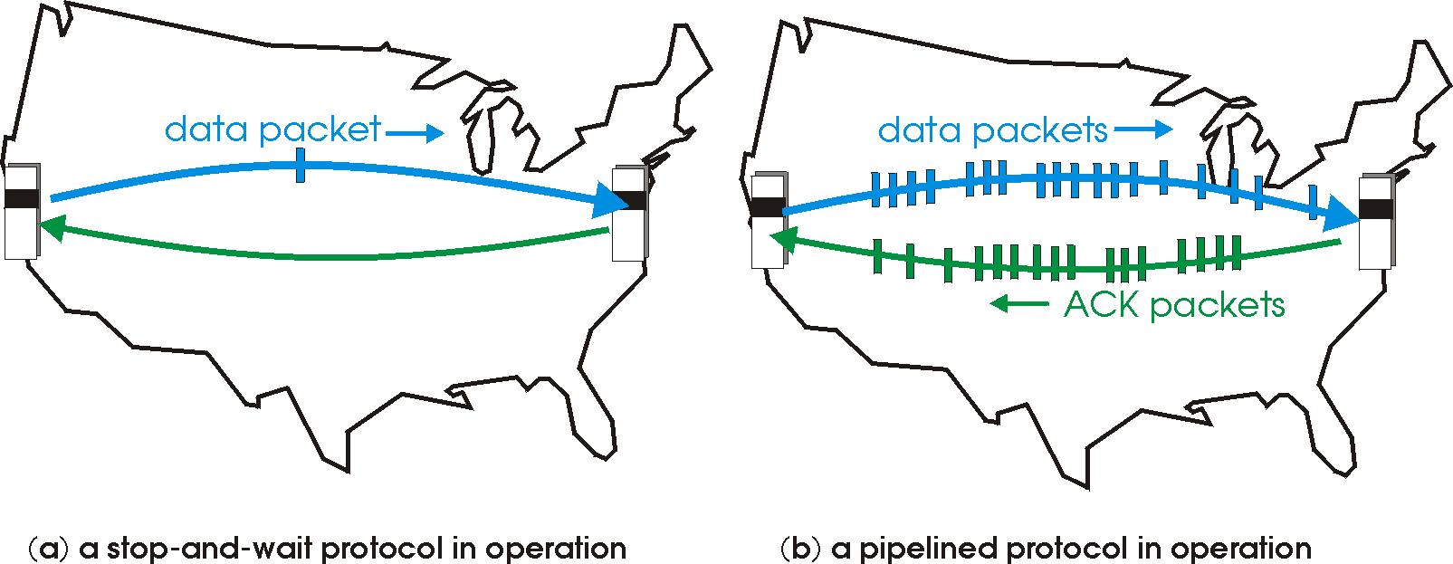
Pipelined protocols
pipelining: sender allows multiple, “in-flight”, yet-to-be-acknowledged pkts
range of sequence numbers must be increased
buffering at sender and/or receiver
two generic forms of pipelined protocols: go-Back-N, selective repeat

Slide 15
Pipelining: increased utilization
sender
receiver
first packet bit transmitted, t = 0
last bit transmitted, t = L / R
first packet bit arrives
RTT
last packet bit arrives, send ACK
last bit of 2nd packet arrives, send ACK
last bit of 3rd packet arrives, send ACK
ACK arrives, send next
packet, t = RTT + L / R
3-packet pipelining increases
utilization by a factor of 3!

Slide 16
Pipelined protocols: overview
Go-back-N:
sender can have up to N unacked packets in pipeline
receiver only sends cumulative ack
doesn’t ack packet if there’s a gap
sender has timer for oldest unacked packet
when timer expires, retransmit all unacked packets
Selective Repeat:
sender can have up to N unack’ed packets in pipeline
rcvr sends individual ack for each packet
sender maintains timer for each unacked packet
when timer expires, retransmit only that unacked packet

Slide 17
TCP: retransmission scenarios
Host A
Host B
Host A
Host B
SendBase=92
Seq=92, 8 bytes of data
Seq=92, 8 bytes of data
timeout
timeout
Seq=100, 20 bytes of data
ACK=100
X
ACK=100
ACK=120
Seq=92, 8 bytes of data
Seq=92, 8
bytes of data
SendBase=100
SendBase=120
ACK=100
ACK=120
SendBase=120
lost ACK scenario
premature timeout

Slide 18
TCP: retransmission scenarios
Host A
Host B
Seq=92, 8 bytes of data
Seq=100, 20 bytes of data
timeout
ACK=100
X
ACK=120
Seq=120, 15 bytes of data
cumulative ACK

Slide 19
TCP fast retransmit
time-out period often relatively long:
long delay before resending lost packet
detect lost segments via duplicate ACKs.
sender often sends many segments back-to-back
if segment is lost, there will likely be many duplicate ACKs.
TCP fast retransmit
if sender receives 3 ACKs for same data
(“triple duplicate ACKs”), resend unacked segment with smallest seq #
likely that unacked segment lost, so don’t wait for timeout
(“triple duplicate ACKs”),

Slide 20
TCP fast retransmit
Host A
Host B
Seq=92, 8 bytes of data
Seq=100, 20 bytes of data
X
ACK=100
timeout
ACK=100
ACK=100
ACK=100
Seq=100, 20 bytes of data
fast retransmit after sender
receipt of triple duplicate ACK

Slide 21
TCP: closing a connection
client state
server state
ESTAB
ESTAB
clientSocket.close()
FIN_WAIT_1
can no longer
send but can
receive data
FINbit=1, seq=x
CLOSE_WAIT
ACKbit=1; ACKnum=x+1
can still
send data
FIN_WAIT_2
wait for server
close
LAST_ACK
FINbit=1, seq=y
TIMED_WAIT
can no longer
send data
ACKbit=1; ACKnum=y+1
timed wait
for 2*max
segment lifetime
CLOSED
CLOSED

